Slide 1
Condition assessment of pressurized tubular structure using wave data
Najoua HAMDAOUI (CIVL)
nhamdaoui@connect.ust.hk
Math5473

Slide 2
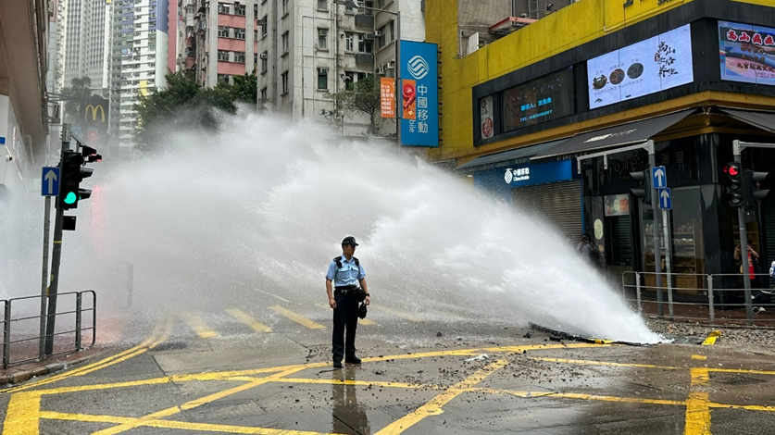
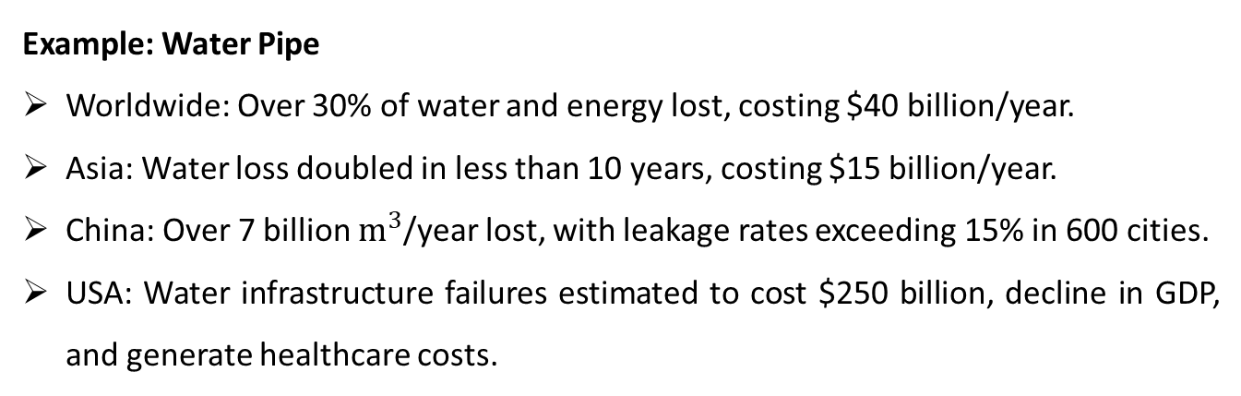
Introduction
Aging, deteriorating infrastructure plagued with inefficiencies and deficiencies.
Catastrophic failures leading to property damage, disruptions, and hazards.
Example: Water Pipe
Worldwide: Over 30% of water and energy lost, costing $40 billion/year.
Asia: Water loss doubled in less than 10 years, costing $15 billion/year.
China: Over 7 billion $m^{3}$/year lost, with leakage rates exceeding 15% in 600 cities.
USA: Water infrastructure failures estimated to cost $250 billion, decline in GDP, and generate healthcare costs.
Burst Water Pipe Kennedy Town (24th Apr 2024)
There is a need to conduct condition assessment of such critical structure

Slide 3
Condition assessment
Data Collection: Gather relevant information and data (wave data in this project).
Damage Determination: Determine whether damage is present or not (classification)
Damage Evaluation: If damage is identified, assess the size and location of the damages (localization and sizing)

Slide 4
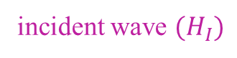
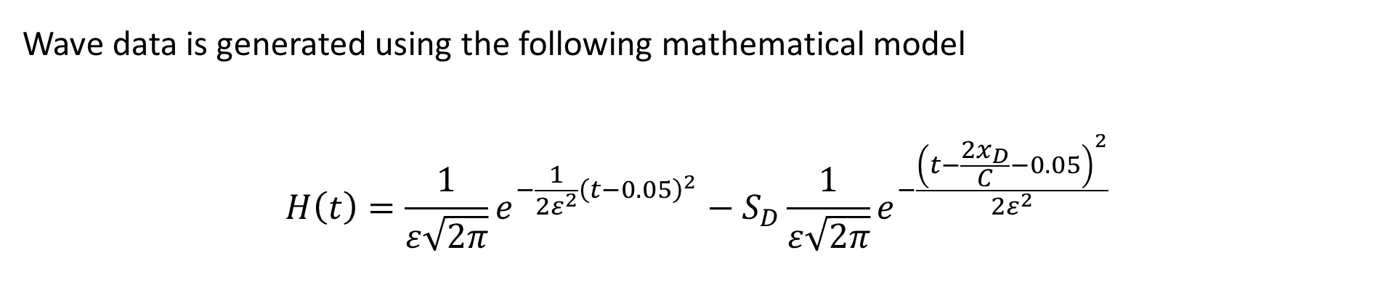
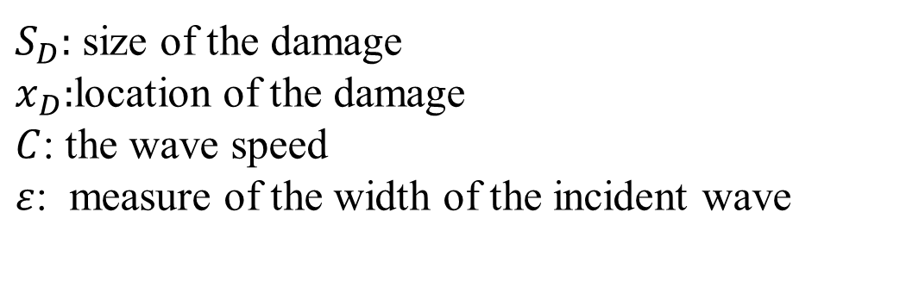
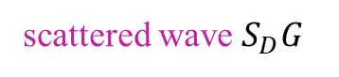
I. Data collection using mathematical model
Wave data is generated using the following mathematical model
$$H\left(t\right)=\frac{1}{ε\sqrt{2π}}e^{−\frac{1}{2ε^{2}}{\left(t−0.05\right)}^{2}}−S_{D}\frac{1}{ε\sqrt{2π}}e^{−\frac{{\left(t−\frac{2x_{D}}{C}−0.05\right)}^{2}}{2ε^{2}}}$$
incident wave $(H_{I})$
scattered wave $S_{D}G$
$S_{D}:$size of the damage
$x_{D}:$location of the damage
$C$: the wave speed
$ε$: measure of the width of the incident wave

Slide 5
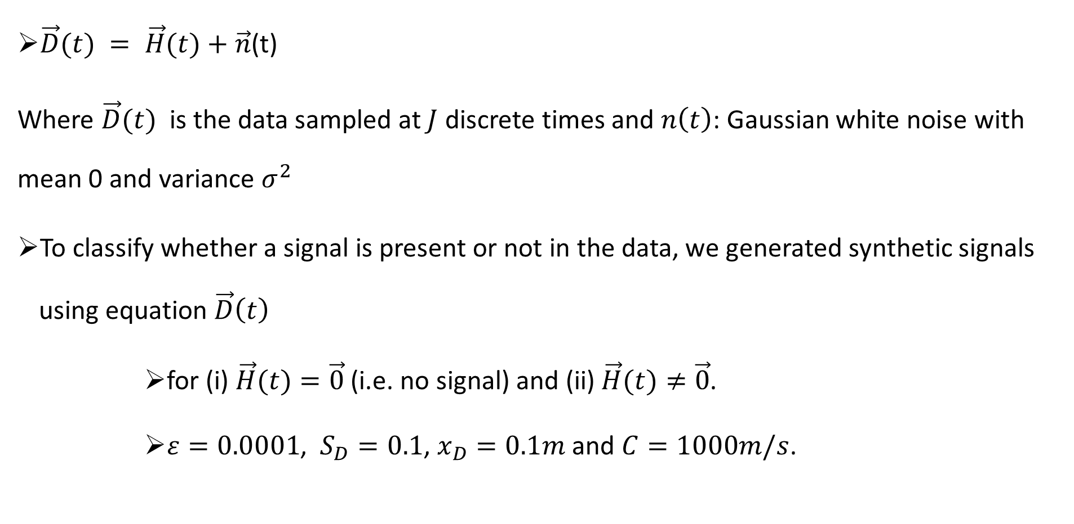
Data collection using mathematical model
$\vec{D}(t) = \vec{H}(t)+\vec{n}$(t)
Where $\vec{D}(t)$ is the data sampled at $J$ discrete times and $n\left(t\right)$: Gaussian white noise with mean 0 and variance $σ^{2}$
To classify whether a signal is present or not in the data, we generated synthetic signals using equation $\vec{D}\left(t\right)$
for (i) $\vec{H}(t)=\vec{0}$ (i.e. no signal) and (ii)$\vec{H}(t)≠\vec{0}$.
$ε=0.0001$, $S_{D}=0.1$, $x_{D}=0.1m$ and $C=1000m/s$.

Slide 6
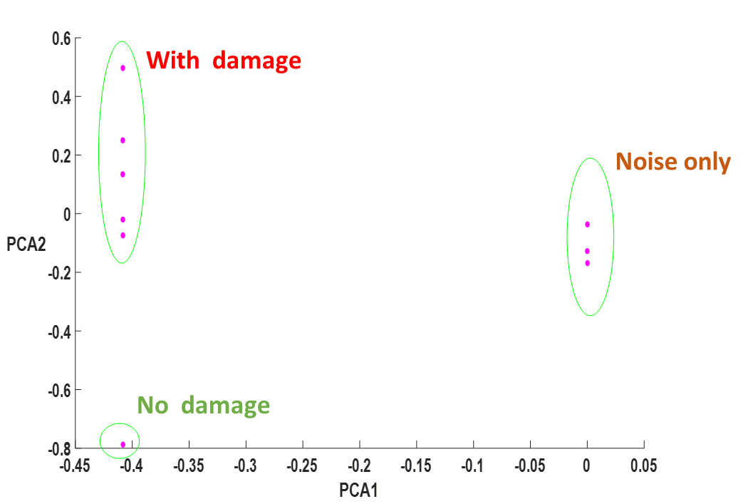
Classification using PCA

Slide 7
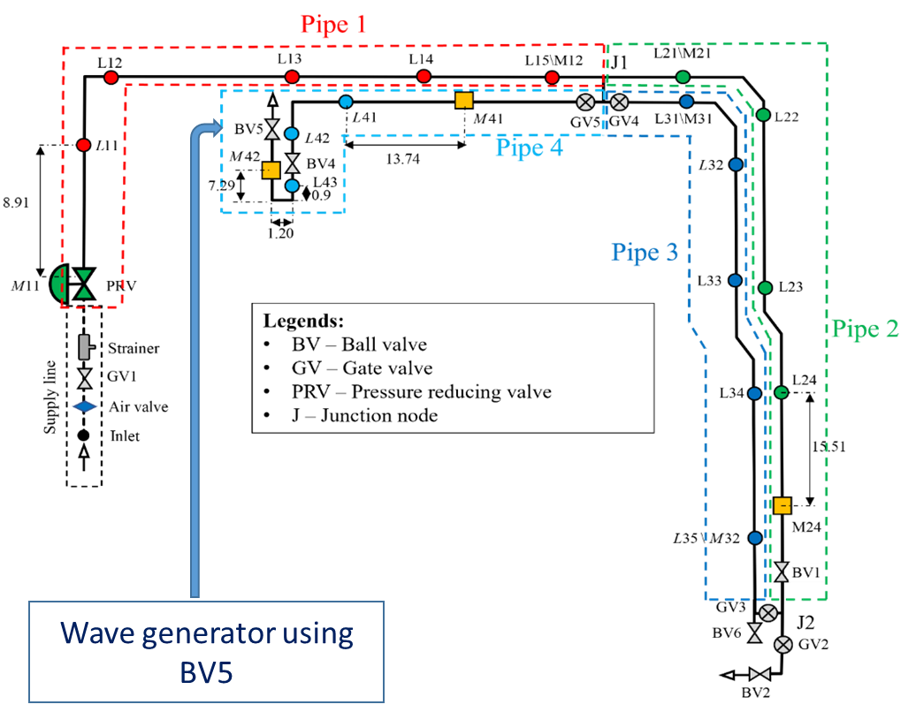
II. Data Collection in the field
BH facility (Kowloon, Hong Kong) setup sketch: co-owned by WSD and HKUST

Slide 8
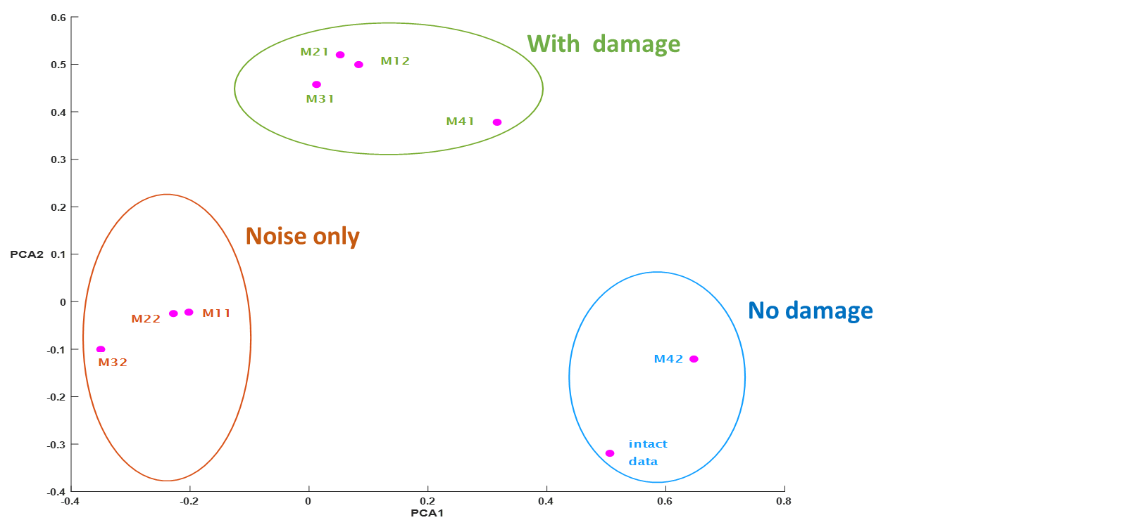
Classification using PCA
We applied PCA to the wave data collected at BH facility: (i) case with damage and (ii) case without damage

Slide 9
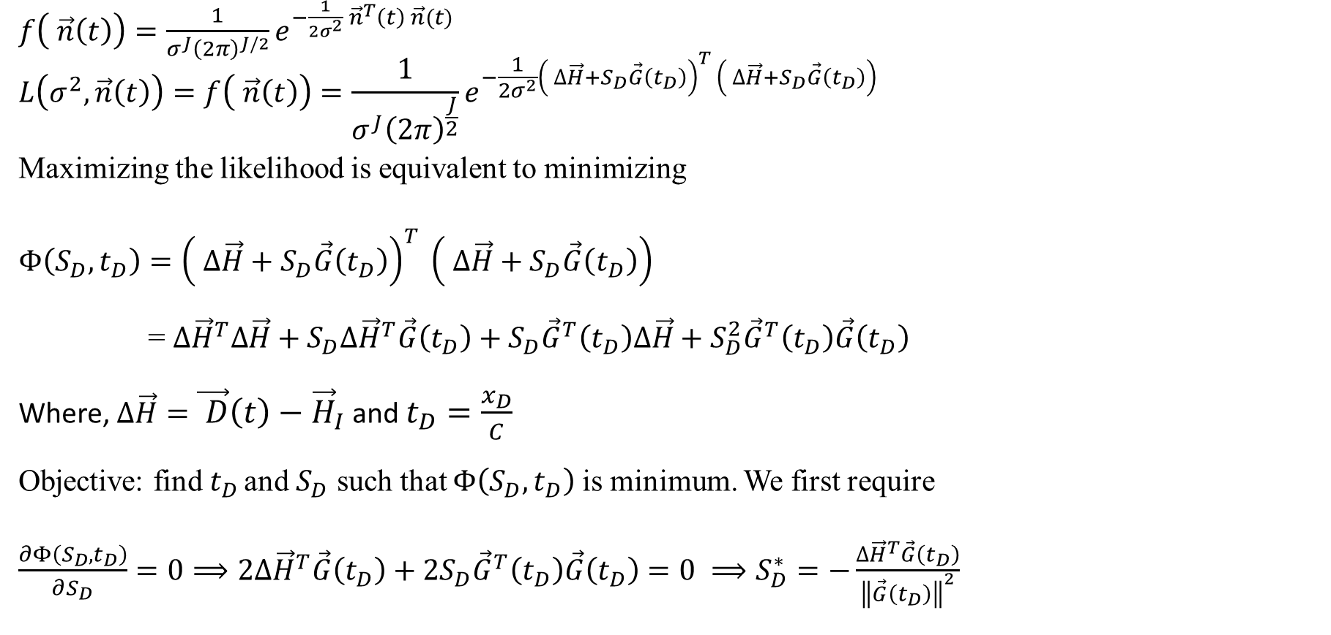
III. Localization and sizing of damage using MLE: theory
$f\left( \vec{n}\left(t\right)\right)=\frac{1}{σ^{J}{\left(2π\right)}^{J/2}}e^{−\frac{1}{2σ^{2}} {\vec{n}}^{T}\left(t\right) \vec{n}(t)}$
$$L\left(σ^{2}, \vec{n}\left(t\right)\right)=f\left( \vec{n}\left(t\right)\right)=\frac{1}{σ^{J}{\left(2π\right)}^{\frac{J}{2}}}e^{−\frac{1}{2σ^{2}}{\left( ∆\vec{H}+S_{D}\vec{G}\left(t_{D}\right)\right)}^{T} \left( ∆\vec{H}+S_{D}\vec{G}\left(t_{D}\right)\right)}$$
Maximizing the likelihood is equivalent to minimizing
$$Φ\left(S_{D}, t_{D}\right)={\left( ∆\vec{H}+S_{D}\vec{G}\left(t_{D}\right)\right)}^{T} \left( ∆\vec{H}+S_{D}\vec{G}\left(t_{D}\right)\right)$$
= ${∆\vec{H}}^{T}∆\vec{H}+S_{D}{∆\vec{H}}^{T}\vec{G}\left(t_{D}\right)+S_{D}{\vec{G}}^{T}\left(t_{D}\right)∆\vec{H}+S_{D}^{2}{\vec{G}}^{T}\left(t_{D}\right)\vec{G}\left(t_{D}\right)$
Where, $∆\vec{H}=\vec{ D}\left(t\right)−{\vec{H}}_{I}$ and $t_{D}=\frac{x_{D}}{C}$
Objective: find $t_{D }$and $S_{D}$ such that $Φ\left(S_{D}, t_{D}\right)$is minimum. We first require
$\frac{∂Φ\left(S_{D}, t_{D}\right)}{∂S_{D}}=0⟹2{∆\vec{H}}^{T}\vec{G}\left(t_{D}\right)+2S_{D}{\vec{G}}^{T}\left(t_{D}\right)\vec{G}\left(t_{D}\right)=0 ⟹S_{D}^{∗}=−\frac{{∆\vec{H}}^{T}\vec{G}\left(t_{D}\right)}{{\left\|\vec{G}\left(t_{D}\right)\right\|}^{2}}$

Slide 10
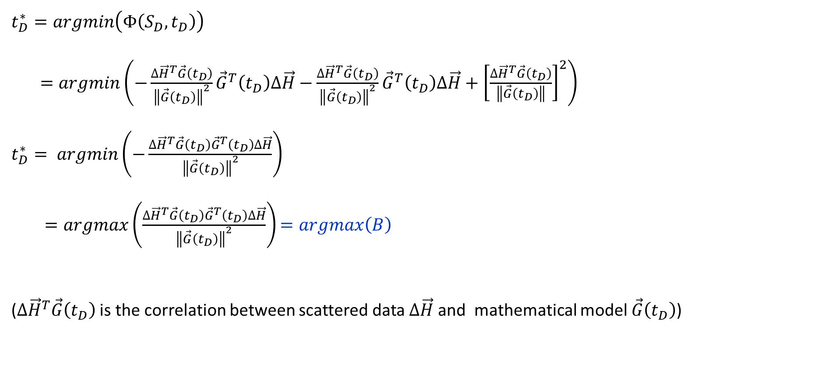
III. Localization and sizing of damage using MLE: theory
$t_{D}^{∗}=argmin\left(Φ\left(S_{D}, t_{D}\right)\right)$
$=argmin\left(−\frac{{∆\vec{H}}^{T}\vec{G}\left(t_{D}\right)}{{\left\|\vec{G}\left(t_{D}\right)\right\|}^{2}}{\vec{G}}^{T}\left(t_{D}\right)∆\vec{H}−\frac{{∆\vec{H}}^{T}\vec{G}\left(t_{D}\right)}{{\left\|\vec{G}\left(t_{D}\right)\right\|}^{2}}{\vec{G}}^{T}\left(t_{D}\right)∆\vec{H}+{\left[\frac{{∆\vec{H}}^{T}\vec{G}\left(t_{D}\right)}{\left\|\vec{G}\left(t_{D}\right)\right\|}\right]}^{2}\right)$
$t_{D}^{∗}= argmin\left(−\frac{{∆\vec{H}}^{T}\vec{G}\left(t_{D}\right){\vec{G}}^{T}\left(t_{D}\right)∆\vec{H}}{{\left\|\vec{G}\left(t_{D}\right)\right\|}^{2}}\right)$
$=argmax\left(\frac{{∆\vec{H}}^{T}\vec{G}\left(t_{D}\right){\vec{G}}^{T}\left(t_{D}\right)∆\vec{H}}{{\left\|\vec{G}\left(t_{D}\right)\right\|}^{2}}\right)$ $=argmax\left(B\right)$
(${∆\vec{H}}^{T}\vec{G}\left(t_{D}\right)$ is the correlation between scattered data $∆\vec{H}$ and mathematical model $\vec{G}\left(t_{D}\right)$)

Slide 11
Behavior of B
Let’s look at the behavior of $B$ by plotting it for $t∈\left[0, 2\right]s$; $t_{D}∈\left[0, 0.2\right]s$;$ε=0.0001$; $C=1000m/s$ and the noise is white and Gaussian with mean 0, $σ=80$ and signal to noise ratio (SNR)$=log\left(1/σ^{2}ε^{2}2π\right)=3.4dB$.
The power function $B$ versus the time $t_{D}$ is highly nonlinear and non-convex
Classical gradient search methods are inefficient and there is no guarantee they can achieve global maximum

Slide 12
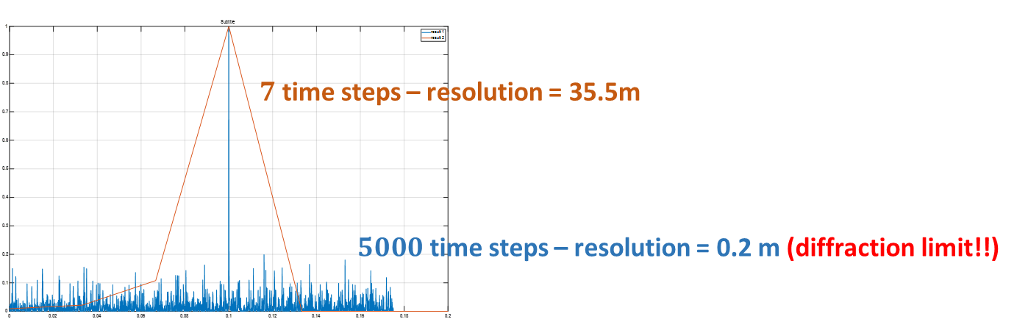
Coarse and fine discretization for single damage
Both discretization lead to an accurate estimates of the actual location and size of the damage although the $5000$ discretization produces slightly better size estimate
The coarse discretization has completely wiped out all the side lobes. Secondary damages (with$\sim 20\%$of the power of the main lobe or smaller) cannot be identified by the coarse discretization.

Slide 13
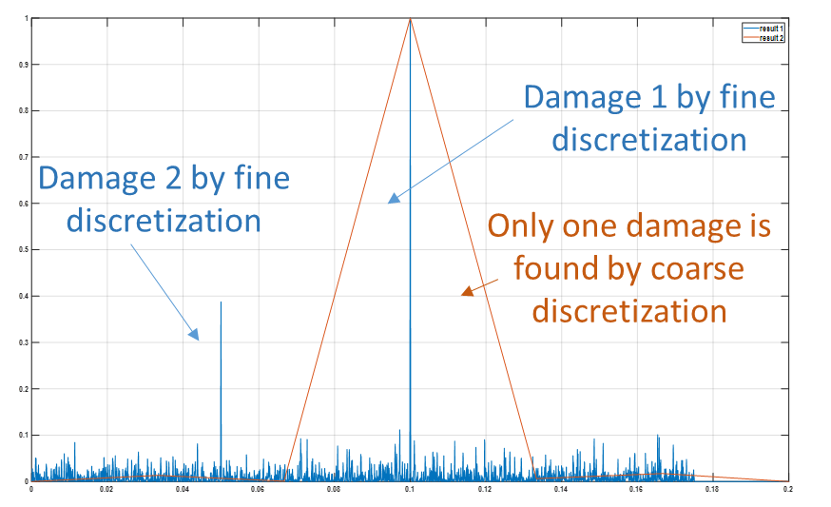
Coarse and fine discretization for multiple damages (2)
Distance between 2 damages is 50m
Distance between 2 damages is 0.1m
Both damages are identified for the fine discretization because the distance between the two damages (50m) is significantly larger than the resolution limit (0.2m).
the 2 damages cannot be resolved even by fine discretization since separation (0.1m) < diffraction limit (0.2m)

Slide 14
Conclusion
PCA is a powerful method for clustering and optimizing sensor locations to identify damages within a structure. It captures essential information from the data and reduces the number of features, improving clustering algorithms and identifies redundant sensors.
PCA is efficient in classifying damages from non-damages by extracting significant variations in the data.
Maximum Likelihood Estimation (MLE) accurately estimates the location and size of damages in structures.
The MLE method is a high resolution technique since it achieves the diffraction limit.

Slide 15
Thank you

